Slide 1
Copy for List, Dict

Slide 2
建立及使用別名
foo
[1, 2, 3]
foo = [1, 2, 3]
boo = foo # 建立 boo 為foo的別名 alias
boo[1] = 100
# where is foo and boo
foo_address = id(foo)
boo_address = id(boo)
boo
boo[1] = 100
foo
[1,100, 3]
boo
foo = ['me', 'i']
foo_address = id(foo)
boo = foo
boo_address = id(boo)
spam = ['me', 'i']
spam_address = id(spam)
chk1 = foo is boo
chk2 = foo is spam
chk3 = (foo == spam)

Slide 3
Methods to Copy Mutable Objects
複製出完全一樣的可修改物件
nl = list(l) or nl = l.copy()
nd = dict(d) or nd = d.copy()
ns = set(s) or ns = s.copy()
複製出排序好的新串列
走訪可修改物件來處理其中的元素
spam = [1, 2, 3, 4]
foo = spam # alias
eggs = list(spam) # copy a list
spam_id = id(spam)
foo_id = id(foo)
eggs_id = id(eggs)
ages = [23, 4, 67, 2]
# in place sort
ages.sort()
scores = [2, 1, 3]
# NOT in place sort
sorted_score = sorted(scores)
songs = [1, 1, 5, 4]
songs_copy = songs.copy()
songs = []
for s in songs_copy:
if s != 1:
songs.append(s)
print(songs)
Notes:
• 第四章 容器賀料型別
› [c(0] for c in grade]
167,71,771
› max([c[-1] for c in grade]) 69
分，在下一章中會有較詳細的說明。
這是利用串列生成式配合
grade 最後一行的最大值。
4.2 tuple 資料型別
ape和A 類似、也是由一連串有序的資料所組成，不過 wuple一旦定韆之後，種酸東就不能更改（Inmutable）。在中文裡並沒有一個很貼切的名稱來翻譯 tuple，一股時觀譯成「元組」或「序對」。本書習慣把 tuple 稱為序對，或是直接以 tuple 來稱呼包，
4.2.1 序對的建立
序對是以逗號區隔元素來表示，但是在可能會混淆語法的地方應加上圓括號區隔開，避解譯錯誤。我們也可以利用tuple（函數來建立一個序對。
•tuple（ 函數
﻿［（7,3,9） ［（7.3,9）1
﻿﻿list ((7,3,9)) 【7 3,91
﻿﻿tuple (range （5,6,7，
﻿﻿tuple([1,4 （1,4,8
﻿﻿tuple('r （'

Slide 4
淺層複製(Shallow Copy)
boo[0] = 1
boo[1][0] = 100
foo (9136) ['a' , 'd']
[ , ]
foo (9136) ['a', 'd']
[ , ]
foo (6080) ['a' , ['c', 'd']]
[ , ]
foo (6080) ['a' , [100, 'd']]
[ , ]
'c' (2800)
'a'
(8272)
'd'
(6912)
'a'
(8272)
'd'
(6912)
'a'
(3904)
[ , ]
(4786)
'c' (2800)
'a'
(3904)
[ , ]
(4786)
'd' (2544)
'd' (2544)
100 (6432)
[ , ]
boo (3472) ['a', 'd']
[ , ]
boo (3472) [1, 'd']
foo = ['a',['c','d']]
boo = foo.copy()
o_foo = id(foo)
o_boo = id(boo)
o_foo_0 = id(foo[0])
o_foo_1 = id(foo[1])
o_boo_0 = id(boo[0])
o_boo_1 = id(boo[1])
o_foo_1_0 = id(foo[1][0])
o_foo_1_1 = id(foo[1][1])
o_boo_1_0 = id(boo[1][0])
o_boo_1_1 = id(boo[1][1])
boo[1][0] = 100
m_foo = id(foo)
m_boo = id(boo)
m_foo_0 = id(foo[0])
m_boo_0 = id(boo[0])
m_foo_1 = id(foo[1])
m_boo_1 = id(boo[1])
m_foo_1_0 = id(foo[1][0])
m_boo_1_0 = id(boo[1][0])
m_foo_1_1 = id(foo[1][1])
m_boo_1_1 = id(boo[1][1])
foo = ['a','d']
boo = foo.copy()
o_foo = id(foo)
o_boo = id(boo)
o_foo_0 = id(foo[0])
o_boo_0 = id(boo[0])
o_foo_1 = id(foo[1])
o_boo_1 = id(boo[1])
boo[0] = 1
m_foo = id(foo)
m_boo = id(boo)
m_foo_0 = id(foo[0])
m_boo_0 = id(boo[0])
m_foo_1 = id(foo[1])
m_boo_1 = id(boo[1])
1
(7632)
[ , ]
boo (6144) ['a', ['c', 'd']
[ , ]
boo (6144) ['a', [100, 'd']
Notes:
shallow copy
# left exmaple
foo = ['a','d']
boo = foo.copy()
o_foo = id(foo)
o_boo = id(boo)
o_foo_0 = id(foo[0])
o_boo_0 = id(boo[0])
o_foo_1 = id(foo[1])
o_boo_1 = id(boo[1])
boo[0] = 1
m_foo = id(foo)
m_boo = id(boo)
m_foo_0 = id(foo[0])
m_boo_0 = id(boo[0])
m_foo_1 = id(foo[1])
m_boo_1 = id(boo[1])
# right example
foo = ['a',['c','d']]
boo = foo.copy()
o_foo = id(foo)
o_boo = id(boo)
o_foo_0 = id(foo[0])
o_boo_0 = id(boo[0])
o_foo_1 = id(foo[1])
o_boo_1 = id(boo[1])
o_foo_1_0 = id(foo[1][0])
o_boo_1_0 = id(boo[1][0])
o_foo_1_1 = id(foo[1][1])
o_boo_1_1 = id(boo[1][1])
boo[1][0] = 100
m_foo = id(foo)
m_boo = id(boo)
m_foo_0 = id(foo[0])
m_boo_0 = id(boo[0])
m_foo_1 = id(foo[1])
m_boo_1 = id(boo[1])
m_foo_1_0 = id(foo[1][0])
m_boo_1_0 = id(boo[1][0])
m_foo_1_1 = id(foo[1][1])
m_boo_1_1 = id(boo[1][1])

Slide 5
深層複製(Deep Copy)
boo[0] = 1
boo[1][0] = 100
foo (3696) ['a' , 'd']
[ , ]
foo (3696) ['a', 'd']
[ , ]
foo (1312) ['a' , ['c', 'd']]
[ , ]
foo (1312) ['a' , ['c', 'd']]
[ , ]
'a'
(2832)
'd'
(1472)
'a'
(2832)
'd'
(1472)
'a'
(8880)
[ , ]
(9744)
'c' (7776)
'a'
(8880)
[ , ]
(9744)
'c' (7776)
'd' (7520)
'd' (7520)
[ , ]
boo (8288) ['a', 'd']
[ , ]
boo (8288) [1, 'd']
[ , ]
(1632)
import copy
foo = ['a',['c','d']]
boo = copy.deepcopy(foo)
o_foo = id(foo)
o_boo = id(boo)
o_foo_0 = id(foo[0])
o_boo_0 = id(boo[0])
o_foo_1 = id(foo[1])
o_boo_1 = id(boo[1])
o_foo_1_0 = id(foo[1][0])
o_boo_1_0 = id(boo[1][0])
o_foo_1_1 = id(foo[1][1])
o_boo_1_1 = id(boo[1][1])
boo[1][0] = 100
m_foo = id(foo)
m_boo = id(boo)
m_foo_0 = id(foo[0])
m_boo_0 = id(boo[0])
m_foo_1 = id(foo[1])
m_boo_1 = id(boo[1])
m_foo_1_0 = id(foo[1][0])
m_boo_1_0 = id(boo[1][0])
m_foo_1_1 = id(foo[1][1])
m_boo_1_1 = id(boo[1][1])
[ , ]
(1632)
100 (1408)
import copy
foo = ['a','d']
boo = copy.deepcopy(foo)
o_foo = id(foo)
o_boo = id(boo)
o_foo_0 = id(foo[0])
o_boo_0 = id(boo[0])
o_foo_1 = id(foo[1])
o_boo_1 = id(boo[1])
boo[0] = 1
m_foo = id(foo)
m_boo = id(boo)
m_foo_0 = id(foo[0])
m_boo_0 = id(boo[0])
m_foo_1 = id(foo[1])
m_boo_1 = id(boo[1])
1
(2192)
[ , ]
boo (1376) ['a', ['c', 'd']
[ , ]
boo (1376) ['a', [100, 'd']

Slide 6
帶你搞懂 Python 的淺層複製(shallow copy)與深層複製(deep copy)
https://www.myapollo.com.tw/blog/python-shallow-copy-vs-deep-cpoy/?fbclid=IwZXh0bgNhZW0CMTEAAR3OPRPZ2qHaeFt1v_-LZ2Hxyu55XY70DHr3useLTX2I4JIGxIOmQaXmPmM_aem_D_4z8dxlWgKha8fn_cijXg
Assignment statements in Python do not copy objects, they create bindings between a target and an object.
For collections that are mutable or contain mutable items, a copy is sometimes needed so one can change one copy without changing the other.
A shallow copy constructs a new compound object and then (to the extent possible) inserts references into it to the objects found in the original.
Shallow copies of dictionaries can be made using dict.copy(), and of lists by assigning a slice of the entire list, for example, copied_list = original_list[:] or copy.copy()
A deep copy constructs a new compound object and then, recursively, inserts copies into it of the objects found in the original.
Compound objects (objects that contain other objects, like lists or class instances)
deep copy 就是符合直覺的複製(copy)，而且不管 compound object 有多深，都會用遞迴的方式建立新的 compound object 。
深層複製只需要呼叫 copy.deepcopy()

Slide 7
Backup

Slide 8
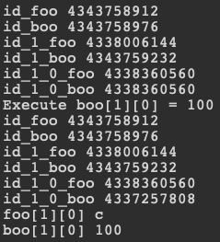
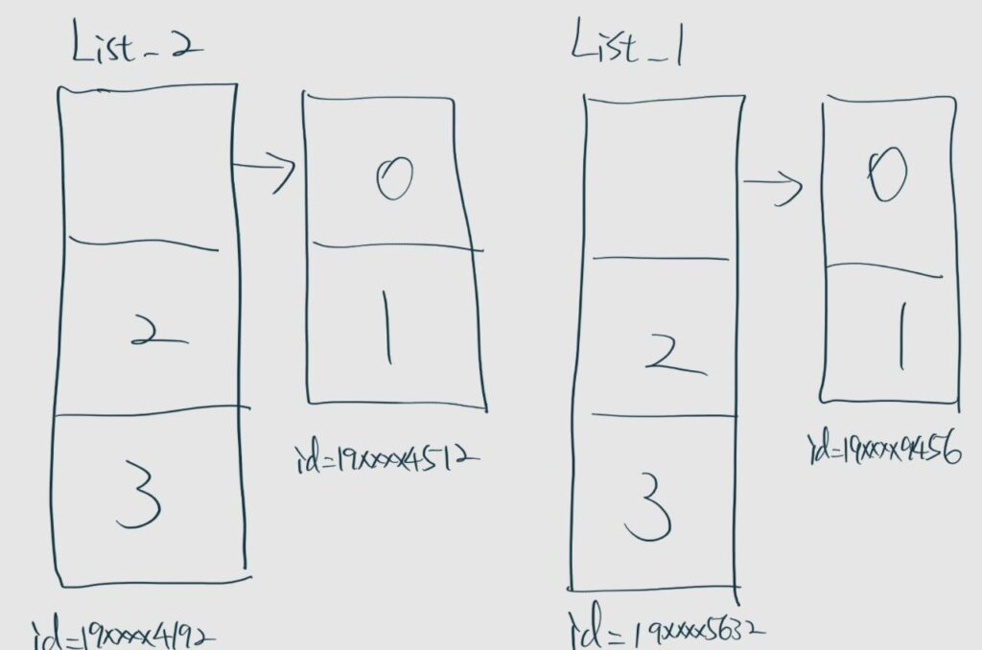
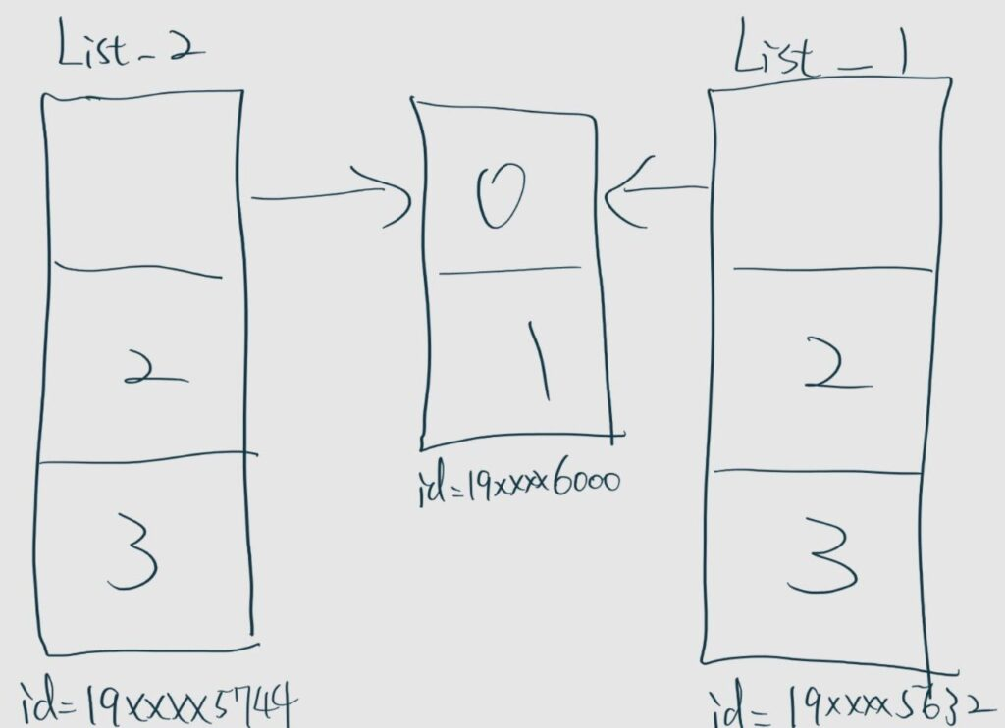
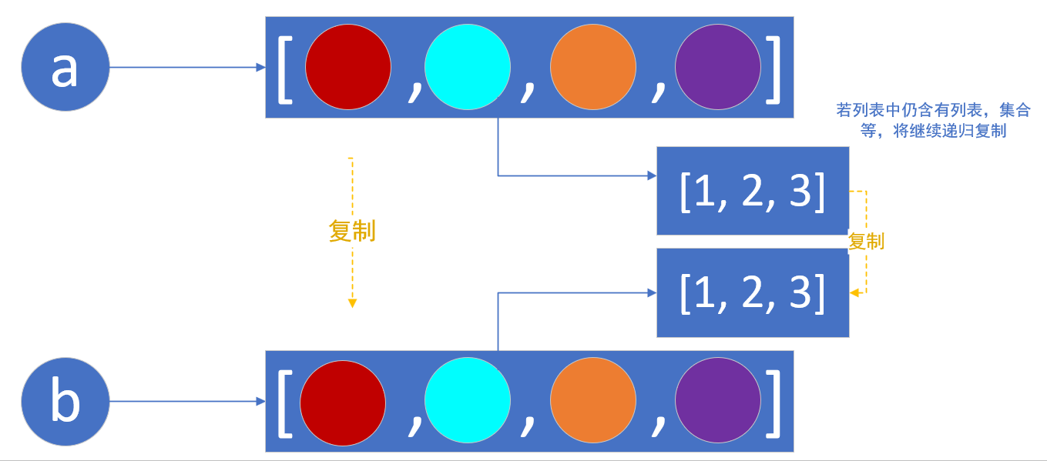
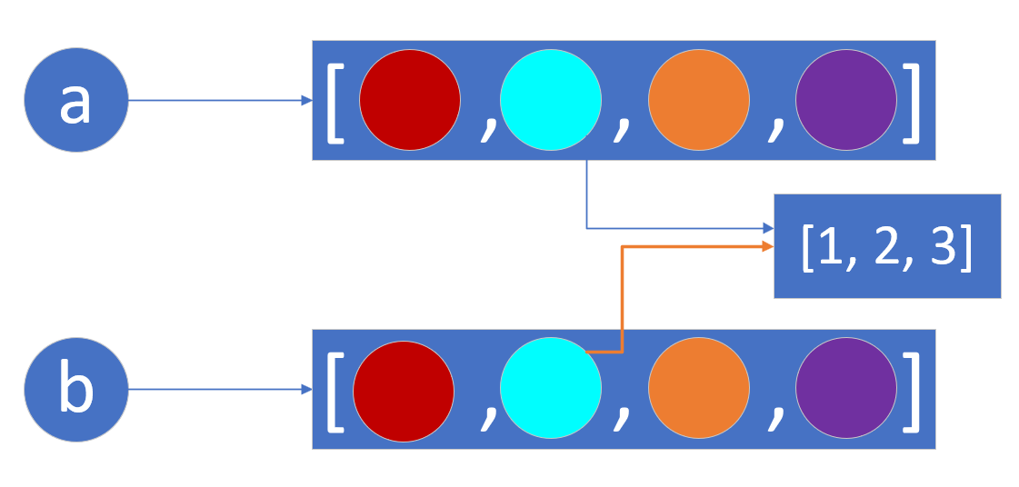
淺層複製(Shallow Copy) 與 深層複製(Deep Copy)
淺層複製(Shallow Copy)
深層複製(Deep Copy)
foo = ['a','d']
boo = foo.copy()
o_foo = id(foo)
o_boo = id(boo)
o_foo_0 = id(foo[0])
o_boo_0 = id(boo[0])
o_foo_1 = id(foo[1])
o_boo_1 = id(boo[1])
# after assign new object 1 to boo[0]
# id of boo[0] will be changed
boo[0] = 1
m_foo = id(foo)
m_boo = id(boo)
m_foo_0 = id(foo[0])
m_boo_0 = id(boo[0])
m_foo_1 = id(foo[1])
m_boo_1 = id(boo[1])
foo = ['a',['c','d']]
boo = foo.copy()
o_foo = id(foo)
o_boo = id(boo)
o_foo_0 = id(foo[0])
o_boo_0 = id(boo[0])
o_foo_1 = id(foo[1])
o_boo_1 = id(boo[1])
o_foo_1_0 = id(foo[1][0])
o_boo_1_0 = id(boo[1][0])
boo[1][0] = 100
m_foo = id(foo)
m_boo = id(boo)
m_foo_0 = id(foo[0])
m_boo_0 = id(boo[0])
m_foo_1 = id(foo[1])
m_boo_1 = id(boo[1])
m_foo_1_0 = id(foo[1][0])
m_boo_1_0 = id(boo[1][0])
import copy
foo = ['a',['c','d']]
boo = copy.deepcopy(foo)
o_foo = id(foo)
o_boo = id(boo)
o_foo_0 = id(foo[0])
o_boo_0 = id(boo[0])
o_foo_1 = id(foo[1])
o_boo_1 = id(boo[1])
o_foo_1_0 = id(foo[1][0])
o_boo_1_0 = id(boo[1][0])
boo[1][0] = 100
m_foo = id(foo)
m_boo = id(boo)
m_foo_0 = id(foo[0])
m_boo_0 = id(boo[0])
m_foo_1 = id(foo[1])
m_boo_1 = id(boo[1])
m_foo_1_0 = id(foo[1][0])
m_boo_1_0 = id(boo[1][0])
Notes:
• 第四章 容器賀料型別
› [c(0] for c in grade]
167,71,771
› max([c[-1] for c in grade]) 69
分，在下一章中會有較詳細的說明。
這是利用串列生成式配合
grade 最後一行的最大值。
4.2 tuple 資料型別
ape和A 類似、也是由一連串有序的資料所組成，不過 wuple一旦定韆之後，種酸東就不能更改（Inmutable）。在中文裡並沒有一個很貼切的名稱來翻譯 tuple，一股時觀譯成「元組」或「序對」。本書習慣把 tuple 稱為序對，或是直接以 tuple 來稱呼包，
4.2.1 序對的建立
序對是以逗號區隔元素來表示，但是在可能會混淆語法的地方應加上圓括號區隔開，避解譯錯誤。我們也可以利用tuple（函數來建立一個序對。
•tuple（ 函數
﻿［（7,3,9） ［（7.3,9）1
﻿﻿list ((7,3,9)) 【7 3,91
﻿﻿tuple (range （5,6,7，
﻿﻿tuple([1,4 （1,4,8
﻿﻿tuple('r （'

